Slide 1
Analysis of survey data and register data — a journey into statistical cultures
Dan Hedlin
Statistics Sweden and Stockholm University

Slide 2
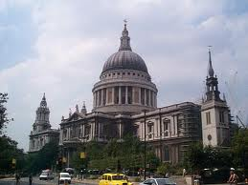
St Paul’s Cathedral, London

Slide 3
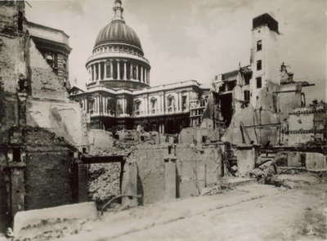
St Paul’s Cathedral in WW2

Slide 4
Protected by energy point?
So was St. Paul's Cathedral protected in World War 2 by an important energy point? Fanciful perhaps but how else could it have remained upstanding when all around was being flattened?

Slide 5
St Paul’s on a ley line?

Slide 6
St Paul’s Cathedral, London
Statistician says:
Hits | 0 | 1 | 2 | 3 | 4 | 5+
Obs | 229 | 211 | 93 | 35 | 7 | 1
Pred | 226.7 | 211.3 | 98.5 | 30.6 | 7.4 | 1.6
N= 576 areas, size ¼ km² each
Total number of bombs= 537
Poisson distribution gives predicted values, and a very god fit (Clarke 1946)

Slide 7
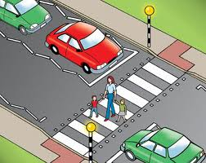
Accidents 50% up!

Slide 8
Statistical cultures
50%! Someone must take action now!
Is this significant?
Is this statistically significant and cost-effective?

Slide 9
What is statistics?
“Statistics is about variation”.
Too wide!
Statistics is concerned with random variation and constants which cannot be measured. (Smith 1999).

Slide 10
What is random?
If all accidents are recorded then there is nothing at random? So what do we do with statistics then?
We need randomness, we feed on randomness

Slide 11
What is random?
Statistician says:
Poisson process. With some probability accidents happen
What is the rationale? We know how many accidents that did happen this year and last year, 50% more this year

Slide 12
What is random?
Probably best way to explain to non-statistician: how do we know that this increase is not just temporary?

Slide 13
What is random?
Statistician says:
Things are random. It is a truly random process.
Modelled by a Poisson process

Slide 14
Process control
Industry statistician says:
Things are random. It is a truly random process. But is it common cause randomness or special cause randomness?
If the extremes of the process stays within bounds, then it is common cause randomness (non-avoidable, everyday randomness)

Slide 15
Process control
In process control often ± 3 sigma is used, which covers more than 99% of the total probability mass. Why such a wide interval?
Else there would be many false alarms. There are many processes in a factory and the are run 24/7. If outside intervals, “special cause” variation. Within, “process is stable”.

Slide 16
Multiple hypotheses Statistical cultures
Process control: tough to reject hypothesis
Pharmaceutical: Familywise error rate (e.g. Bonferroni method)
Epidemiology: no adjustment for multiple testing (Rothman 1990)
What about official statistics?

Slide 17
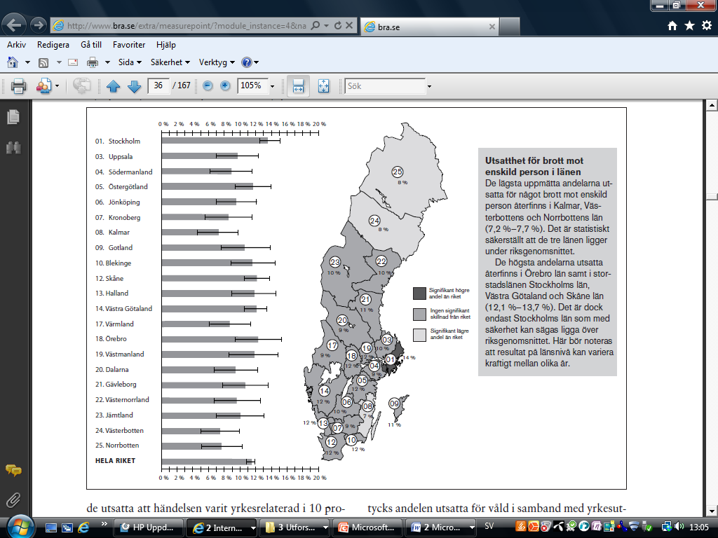

Slide 18
Returning to St Paul’s Cathedral
What if there was a statistically significant lack of fit. Then the Poisson model would not fit, hence ....

Slide 19
Returning to St Paul’s Cathedral
What if?
Hits | 0 | 1 | 2 | 3 | 4 | 5+
Obs | 229 | 211 | 93 | 35 | 7 | 1
Pred | 226.7 | 211.3 | 98.5 | 30.6 | 7.4 | 1.6
What if large number here?
There is a similar example in Lohr (2010) on accidents and airline pilots

Slide 20
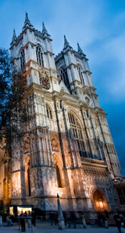
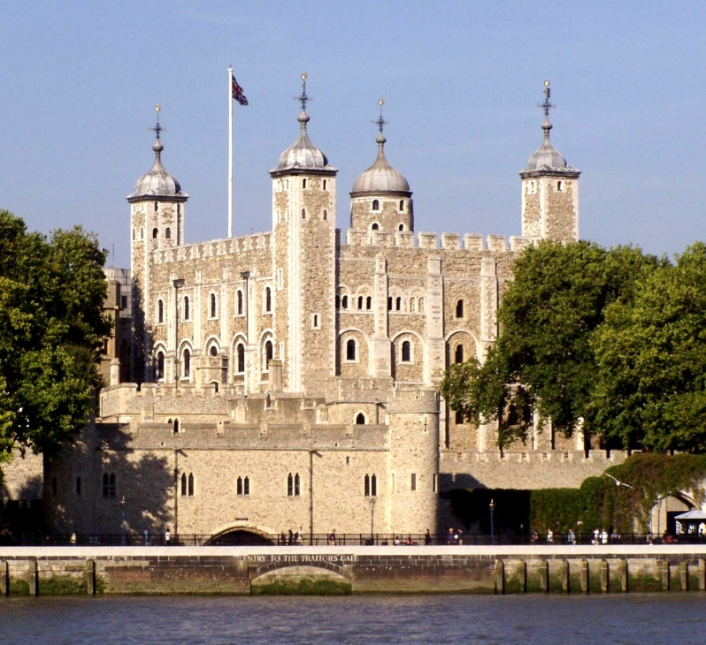
No, it is not that easy

Slide 21
Undefined sample space
Very common.
Question to ask oneself: how was the object/event/situation at hand selected? Was it selected because of its remarkable features (e.g. many accidents)

Slide 22
Undefined sample space
Note difference between Lohr’s airline pilots example and the accidents in the crossing: we have data on all airline accidents and pilots. That crossing was selected on the bases on its properties (informative sample)

Slide 24
Scenarios in thought-experiment
Suppose the far North was particularly prone to crime
A statistician would have checked it and asked questions. Perhaps second thoughts about testing procedure.
If published, people analysing statistics would have “found” reasons (high unemployment, women move out, etc)
Recall “ley line”

Slide 25
Statistical culture
In pharmaceutical industry:
Studies are planned, primary hypothesis selected. Reported ahead of time.
Downsides: No flexibility, expensive, time consuming.
Perhaps there should be different statistical cultures

Slide 26
Sweden’s first fully register-based census this year
Apart-ments
Properties (houses)
Population
One of the statistical issues: what proportion live in cramped apartments?
What is random?

Slide 27
“Usual” sources of error
Undercoverage
Missing values (here missing links)
Incorrect values
No sampling error though

Slide 28
Statistical cultures
Various “register-based cultures”, including “just count the numbers, there is no random variation”
“No errors, after you have corrected them. So no random variation.”
Very common indeed

Slide 29
Not much research on register-based statistics.
For a different framework, see Zhang (2010)
Imputation etc does lead to random variation. E.g. multiple imputation to capture this. Imputed values should at least be flagged.

Slide 30
Census-like situations
On the one hand: we have all information (expect for missing values, undercoverage...)
On the under hand, we “desire” randomness
Why?
Because object/event/situation is just one of the scenarios that could have happened

Slide 31
Register-based culture vs common statistical culture
E.g. in Agresti (1990) there are no discussions on this. Models are fitted to census-like data.
Example, page 135, death penalty, victim’s race and defendant’s race. This is a census-like situation. (excellent book btw)
Sentencing viewed as a random process

Slide 32
Exactly what is random?
The jury does not toss a coin
Random: many small and large circumstances that eventually lead to a sentence in court. Individual unexplained variation. Even if you knew all about them, a deterministic model would not helpful. It would be too complex.

Slide 33
What culture should we adopt
...for our register-based census?
Non-statistical “just count culture” (no errors and no uncertainty). Of course not.
Common statistical culture (model)
Intermediate way? Model errors (imputation, measurement errors, undercoverage) but nothing more?

Slide 34
Finite population
Examples: 1) the population of Sweden at a certain point in time 2) local governments in Sweden at a certain point in time
Here: finite population = actual and definite population. ->

Slide 35
The actual and definite population exists in the real world and we could, in principle, investigate it fully.
Note that we have now moved away a bit from “finite” in “finite population”

Slide 36
A finite population parameter is a function of y. For example, mean income.
Finite population of N units, conceptually labelled 1, 2, 3, …, N

Slide 37
Aim of analysis of finite population
Descriptive aim, if we are interested in finite population parameters. “Descriptive population quantity” (Pfeffermann 1993)
Analytic aim if we are interested in model parameters or probabilities based on a model fitted to the finite population.

Slide 38
How do we know whether we are interested in a model parameter or a finite population parameter?

Slide 39
Example (Thompson 1997, p. 199):
Smokers in Ontario…
…whether they have smoked brand A during October => probably descriptive aim (how many smokers in this definite population?)
…whether they have switched brands in the month prior to the survey => then we may be interested in the probability that a randomly selected smoker, in Ontario or a larger area, will switch brands in some future month under similar conditions

Slide 40
Another analytic aim of use of survey data
A shoe manufacturer may be interested in the properties of soles and glue, e.g. what combination offers best quality. Is this manufacturer interested in the 1000 shoes that were produced last month, and from which a sample was taken? Most likely not.
This manufacturer will be interested in the shoes that will be produced under similar conditions. Note that this is a finite population too, but a conceptual one. For example, its size is not determined.

Slide 41
Common analytic aims:
To establish theory about associations (relationships, causal links, etc.) between the variables
To assess the likely impact of policy changes or making predictions about the possible consequences of `no change` policy
To draw conclusions that hold beyond the population at the time it was sampled

Slide 42
So what culture we should adopt...
Descriptive aim or analytic aim. Apparently depends on purpose. Could even have both. Distinction useful but not a barrier

Slide 43
School evaluation
From Goldstein (1995)
Y_{ij} maths score at age 11, pupil i,
school j
x_{ij} maths score at age 8
u_{j} school j (u_{j} random)
Multilevel model

Slide 44
School evaluation cntd
Predict value for a school (variance components model)
n_{j} sample size school j
raw residuals

Slide 45
Small schools are ‘shrunk’ towards average for all schools
Statistician says:
If we have few observations from one school, the best we can do is to estimate this school with the average of all schools. Rationale: lack of knowledge and then we should not assume this school is special if there is no reason.

Slide 46
School says:
Unfair! Just because they could not be bothered to collect information from our school, we are punished with an average estimate.

Slide 47
A different example
Technically the same, but now...
independent variable income
dependent variable(s) e.g. age (levels: individual, and area)
If official statistics, should we use the same model? Let’s say model fit is very good.
National Statistical Institutes tend not to use this type of model – unless n_{j} very small

Slide 48
Why? Complex picture (see Hedlin 2008). Respect for model bias one reason.
Often in official statistics only data from one school is used to make estimates for that school. This is fairly model-free.
Note there are subcultures in official statistics, mainly environmental statistics

Slide 49
Population with 5 domains
Fit one model to all data?
Or take data from one domain only.

Slide 50
If you do use a model, such as the one above, should you use sampling weights?
Debated issue (Chambers & Skinner 2003).
If sample information (stratification, clusters, etc) are included in model, little reason to use weights (Pfeffermann 1993)
However, weights do give some robustness. One way to look at it: with sampling weights you estimate finite population parameters

Slide 51
Trend is towards more extensive use of sampling weights in analysis, and more software that can apply weights.

Slide 52
Also issue on communication of methods.
Briscoe (2004) criticised the way the methods of the British 2001 census came across:
‘There was too much science and too little counting and common sense…. The ONS should publish some worked examples of how numbers were derived to remove the suspicion surrounding the science.’ (There was no reason to be suspicious about the science)

Slide 53
Another expression of culture: “fairly model-free or at least model-undisputed computation”.
In research we are not worried about models. Check them, defend them, and submit. Researcher says: other people are free to try other models.
But researchers do not publish official statistics. The point of official statistics is that they are official.

Slide 54
In official statistics you want to come close to an undisputed estimate.
Choice of model may be hard to defend if being criticised.
Of course true also for choice of sample weights and other decisions

Slide 55
Questions to ask oneself
From what sample space is the object taken? (is there a well-defined sample space?)
How have undercoverage, measurement, measurement errors and missing values been treated?
Is there a problem with multiple testing?

Slide 56
Is the target model parameters or finite population parameters?
Does the model assume iid?
If basis is a sample survey, are the design weights accounted for?
Are the explanations of the result all post-hoc (invented afterwards)?
What does the documentation look like?

Slide 57
Experience
Conducting a survey is a very complex process. There is only so much you can document and many decisions that influence results are overlooked or drown in the complexity.
Probably wise to be careful about small or moderate effect sizes from a single or only a few studies.

Slide 58
One last question
Are these statistical cultures driven by needs and purpose?
Or is there an element of unnecessary variation?

Slide 59
References
Agresti, A., (1990). Categorical Data Analysis. Wiley.
Briscoe, S. (2004). Discussion on the meeting on 'The 2001 census and beyond'. Journal of the Royal Statistical Society: Series A, 167, 229–248.
Chambers, R.L. and Skinner, C.J. (eds) (2003). Analysis of Survey Data. Chichester: Wiley.
Clarke, R.D (1946). An application of the Poisson distribution, Journal of the Institute of Actuaries, vol. 72.
Goldstein, H. (1995). Multilevel Statistical Models, 2nd Ed. London: Arnold. (this edition is available on the internet).
Hedlin, D. (2008). Small Area Estimation: A Practitioner’s Appraisal. Rivista Internazionale di Scienze Sociali, 407‑417.
Lohr, S. (2010). Sampling: Design and Analysis, 2nd ed. Boston: Brookes/Cole.
Pfeffermann, D. (1993). The role of sampling weights when modeling survey data. International Statistical Review, 61, 317‑337.
Rothman, K.J. (1990). No adjustments are needed for multiple comparisons. Epidemiology, vol 1, no 1.
Smith, T.M.F. (1999). Recent Developments in Sample Survey Theory and Their Relevance to Official Statistics. National Statistics: Proceedings of the Government Statistical Service Methodology Conference, 148-162.
Thompson, M.E. (1997). Theory of Sample Surveys. London: Chapman & Hall.
Zhang, L.-C. (2010). Developing Statistical Theories for Register-Based Statistics. Qvintensen, No. 4/2010, 20-22. Available at http://statistikframjandet.se/?page_id=141

